Slide 1
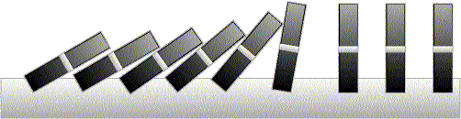
Induction

Slide 2
This Lecture
Last time we have discussed different proof techniques.
This time we will focus on probably the most important one
– mathematical induction.
This lecture’s plan is to go through the following:
The idea of mathematical induction
Basic induction proofs (e.g. equality, inequality, property,etc)
An interesting example
A paradox

Slide 3


Odd Powers Are Odd
Fact: If m is odd and n is odd, then nm is odd.
Proposition: for an odd number m, m^{k} is odd for all non-negative integer k.
Let P(i) be the proposition that m^{i} is odd.
Idea of induction.
P(1) is true by definition.
P(2) is true by P(1) and the fact.
P(3) is true by P(2) and the fact.
P(i+1) is true by P(i) and the fact.
So P(i) is true for all i.

Slide 4
Divisibility by a Prime
Theorem. Any integer n > 1 is divisible by a prime number.
Let n be an integer.
If n is a prime number, then we are done.
Otherwise, n = ab, both are smaller than n.
If a or b is a prime number, then we are done.
Otherwise, a = cd, both are smaller than a.
If c or d is a prime number, then we are done.
Otherwise, repeat this argument, since the numbers are
getting smaller and smaller, this will eventually stop and
we have found a prime factor of n.
Idea of induction.

Slide 5
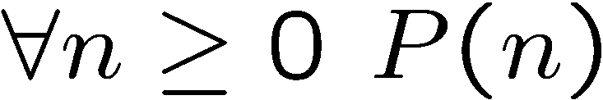
Idea of Induction
Objective: Prove
This is to prove
The idea of induction is to first prove P(0) unconditionally,
then use P(0) to prove P(1)
then use P(1) to prove P(2)
and repeat this to infinity…

Slide 6

The Induction Rule
0 and (from n to n +1),
proves 0, 1, 2, 3,….
P (0), P (n) , P (n+1)
∀m∈N. P (m)
Much easier to prove with P(n) as an assumption.
Very easy to prove
For any n>=0
Like domino effect…

Slide 7
This Lecture
The idea of mathematical induction
Basic induction proofs (e.g. equality, inequality, property,etc)
An interesting example
A paradox

Slide 8
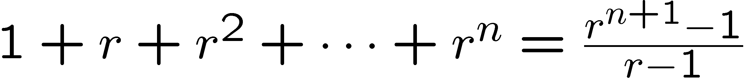
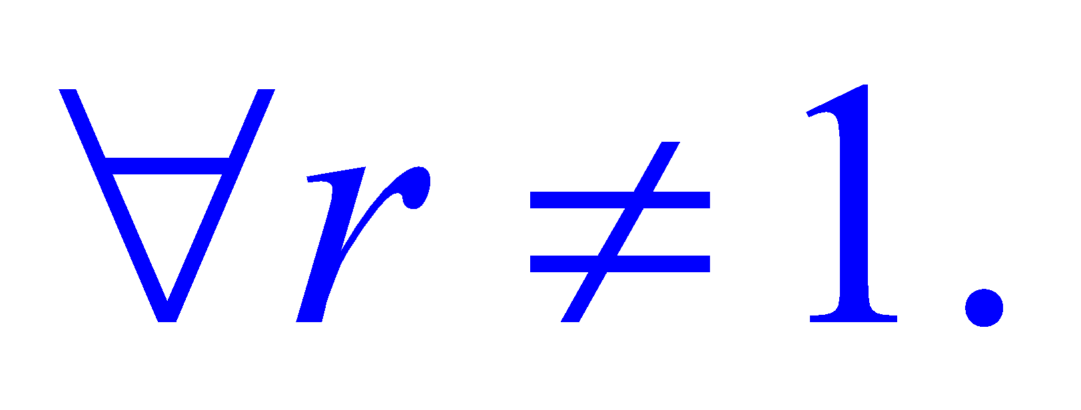
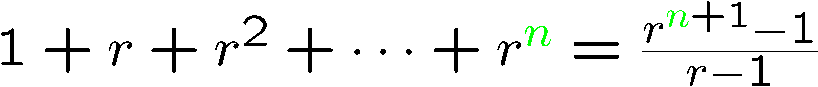
Proof by Induction
Let’s prove:
Statements in green form a template for inductive proofs.
Proof: (by induction on n)
The induction hypothesis, P(n), is:

Slide 9
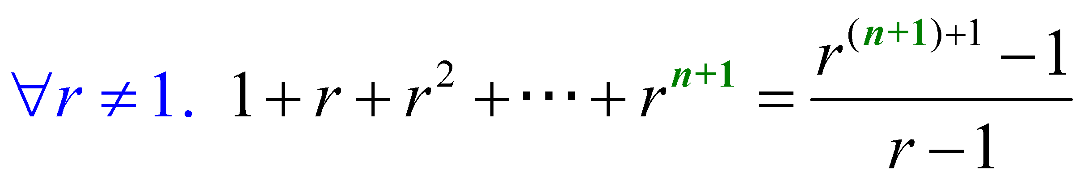
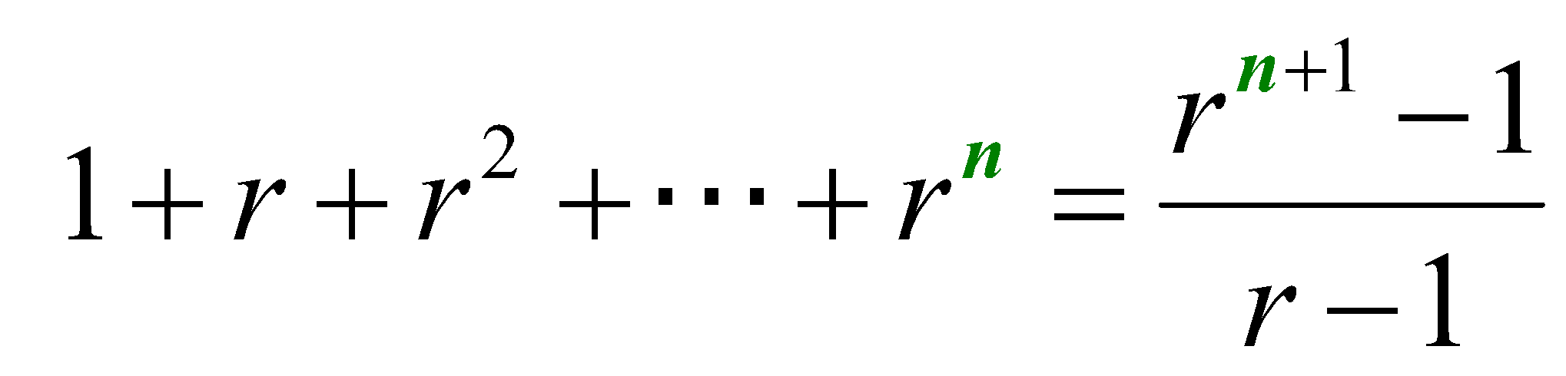
Proof by Induction
Induction Step: Assume P(n) for some n ≥ 0 and prove P(n + 1):
Have P (n) by assumption:
So let r be any number  1, then from P (n) we have
How do we proceed?

Slide 10
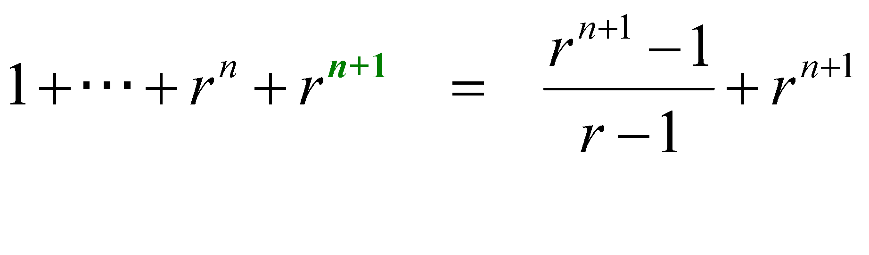
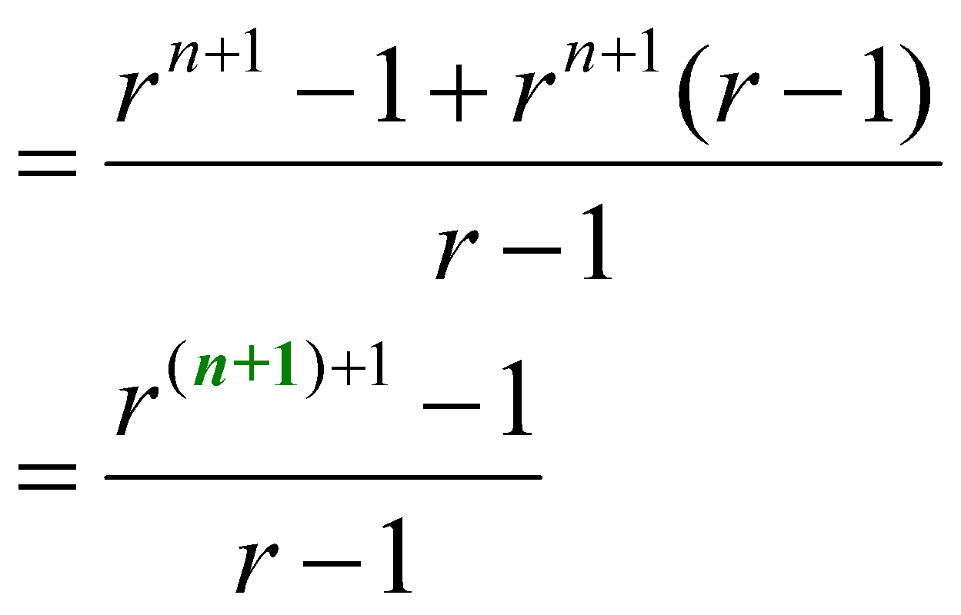
Proof by Induction
adding r ^{n+1} to both sides,
But since r  1 was arbitrary, we conclude (by UG), that
which is P (n+1). This completes the induction proof.

Slide 11
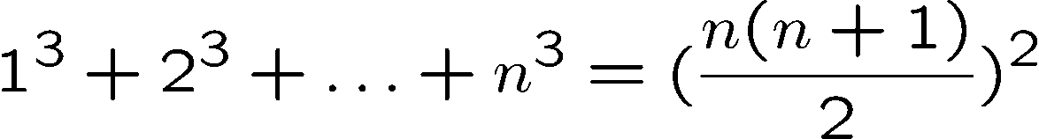

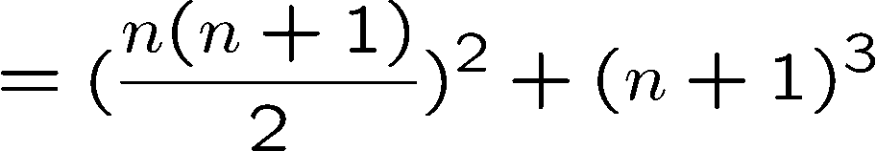

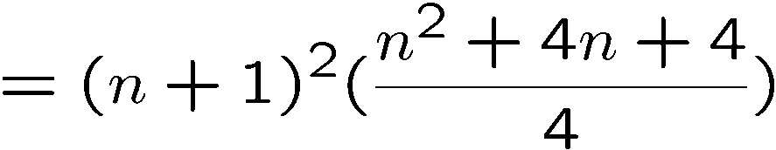
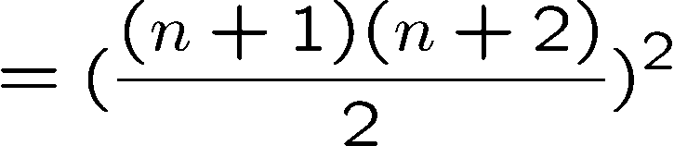
Proving an Equality
Let P(n) be the induction hypothesis that the statement is true for n.
Base case: P(1) is true
Induction step: assume P(n) is true, prove P(n+1) is true.
by induction

Slide 12






Proving a Property
Base Case (n = 1):
Induction Step: Assume P(i) for some i ≥ 1 and prove P(i + 1):
Assume
is divisible by 3, prove
Is divisible by 3.
Divisible by 3
Divisible by 3 by induction

Slide 13





Proving a Property
Base Case (n = 2):
Induction Step: Assume P(i) for some i ≥ 2 and prove P(i + 1):
Assume
is divisible by 6
Prove
is divisible by 6.
Divisible by 6
by induction
Divisible by 2
by case analysis

Slide 14









Proving an Inequality
Base Case (n = 3):
Induction Step: Assume P(i) for some i ≥ 3 and prove P(i + 1):
Assume
, prove
by induction
since i >= 3

Slide 15
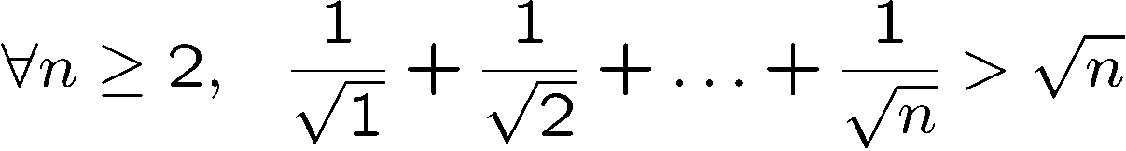
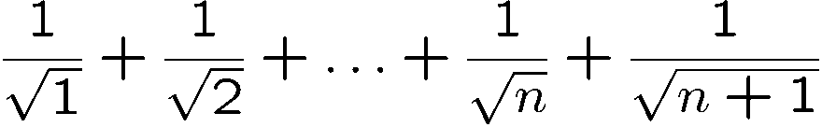
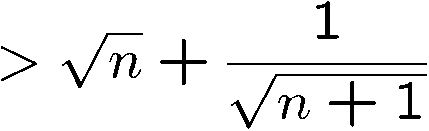
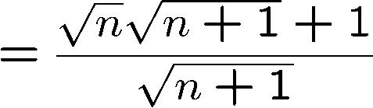
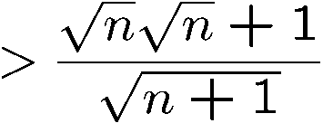
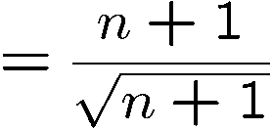

Proving an Inequality
Base Case (n = 2): is true
Induction Step: Assume P(i) for some i ≥ 2 and prove P(i + 1):
by induction

Slide 16
This Lecture
The idea of mathematical induction
Basic induction proofs (e.g. equality, inequality, property,etc)
An interesting example
A paradox

Slide 17
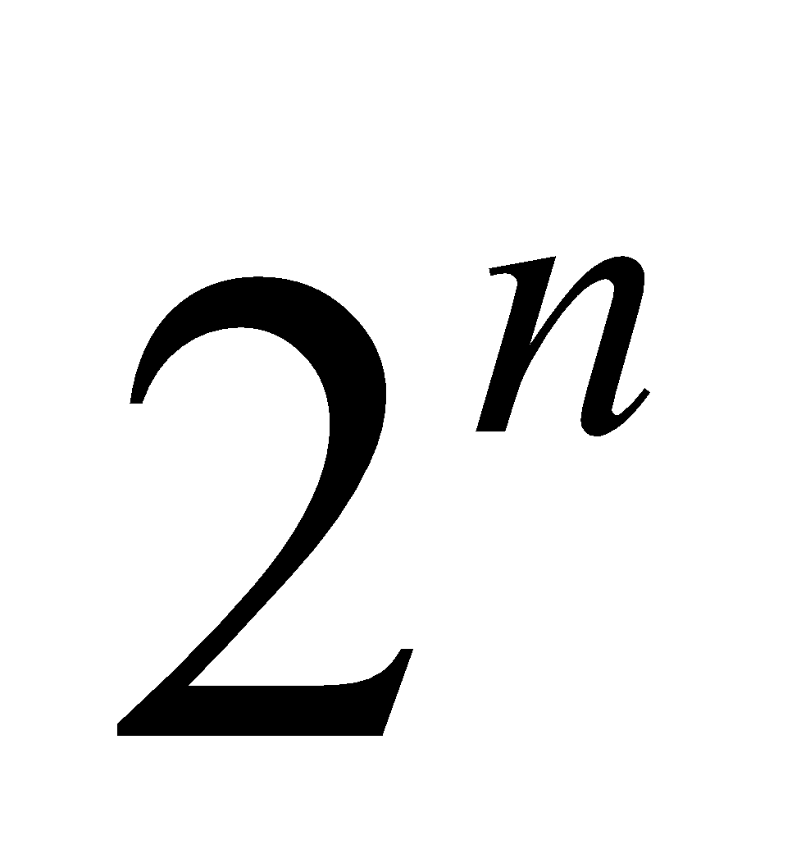

Puzzle
Goal: tile the squares, except one in the middle for Bill.

Slide 18

Puzzle
There are only L-shaped tiles covering three squares:
For example, for 8 x 8 puzzle might tile for Bill this way:

Slide 19

Puzzle
Theorem: For any 2^{n} x 2^{n} puzzle, there is a tiling with Bill in the middle.
Did you remember that we proved
is divisble by 3?
Proof: (by induction on n)
P(n) ::= can tile 2^{n} x 2^{n} with Bill in middle.
Base case: (n=0)
(no tiles needed)

Slide 20
Puzzle
Induction step: assume can tile 2^{n} x 2^{n},
prove can handle 2^{n+1} x 2^{n+1}.
Now what??
2
n
+
1

Slide 21
Puzzle
The new idea:
A stronger property
Prove that we can always find a tiling with Bill anywhere.
Theorem B: For any 2^{n} x 2^{n} puzzle, there is a tiling with Bill anywhere.
Clearly Theorem B implies Theorem.
Theorem: For any 2^{n} x 2^{n} puzzle, there is a tiling with Bill in the middle.

Slide 22
Puzzle
Theorem B: For any 2^{n} x 2^{n} puzzle, there is a tiling with Bill anywhere.
Proof: (by induction on n)
P(n) ::= can tile 2^{n} x 2^{n} with Bill anywhere.
Base case: (n=0)
(no tiles needed)

Slide 23
Puzzle
Induction step:
Assume we can get Bill anywhere in 2^{n} x 2^{n}.
Prove we can get Bill anywhere in 2^{n+1} x 2^{n+1}.

Slide 24
Puzzle
Induction step:
Assume we can get Bill anywhere in 2^{n} x 2^{n}.
Prove we can get Bill anywhere in 2^{n+1} x 2^{n+1}.

Slide 25
Puzzle
Method: Now group the squares together,
and fill the center with a tile.
Done!

Slide 26
Some Remarks
Note 1: It may help to choose a stronger hypothesis
than the desired result (e.g. “Bill in anywhere”).
Note 2: The induction proof of “Bill in corner” implicitly
defines a recursive procedure for finding corner tilings.
Note 3: Induction and recursion are very similar in spirit,
always tries to reduce the problem into a smaller problem.

Slide 27
Gray Code
Can you find an ordering of all the n-bit strings in such a way that
two consecutive n-bit strings differed by only one bit?
This is called the Gray code and has many applications.
How to construct them?
Think inductively! (or recursively!)
2 bit
00
01
11
10
3 bit
000 001 011 010 110 111 101 100
Can you see the pattern?
How to construct 4-bit gray code?

Slide 28
Gray Code
4 bit
3 bit
000 001 011 010 110 111 101 100
3 bit (reversed)
100
101
111
110
010
011
001
000
0
0
0
0
0
0
0
0
1
1
1
1
1
1
1
1
000 001 011 010 110 111 101 100
differed by 1 bit
by induction
differed by 1 bit
by construction
100
101
111
110
010
011
001
000
Every 4-bit string appears exactly once.
differed by 1 bit
by induction

Slide 29
Gray Code
n+1 bit
n bit
000…0
…
…
…
…
…
…
100…0
n bit (reversed)
100…0
…
…
…
…
…
…
000…0
0
0
0
0
0
0
0
0
1
1
1
1
1
1
1
1
000…0
…
…
…
…
…
…
100…0
differed by 1 bit
by induction
differed by 1 bit
by construction
100…0
…
…
…
…
…
…
000…0
Every (n+1)-bit string appears exactly once.
differed by 1 bit
by induction
So, by induction,
Gray code exists for any n.

Slide 30
Hadamard Matrix (Optional)
Can you construct an nxn matrix with all entries +-1 and
all the rows are orthogonal to each other?
Two rows are orthogonal if their inner product is zero.
That is, let a = (a₁, …, a_{n}) and b = (b₁, …, b_{n}),
their inner product ab = a₁b₁ + a₂b₂ + … + a_{n}b_{n}
This matrix is famous and has many applications.
To think inductively, first we come up with small examples.
1
1 -1

Slide 31
Hadamard Matrix (Optional)
Then we use the small examples to build larger examples.
Suppose we have an nxn Hadamard matrix H_{n}.
We can use it to construct an 2nx2n Hadamard matrix as follows.
H_{n} H_{n}
H_{n} -H_{n}
Check this!
So by induction there is a 2^{k} x 2^{k} Hardmard matrix for any k.

Slide 32
Inductive Construction
This technique is very useful.
We can use it to construct:
- codes
- graphs
- matrices
- circuits
- algorithms
- designs
- proofs
- buildings
- …

Slide 33
This Lecture
The idea of mathematical induction
Basic induction proofs (e.g. equality, inequality, property,etc)
An interesting example
A paradox

Slide 34

Paradox
Theorem: All horses are the same color.
Proof: (by induction on n)
Induction hypothesis:
P(n) ::= any set of n horses have the same color
Base case (n=0):
No horses so obviously true!
…

Slide 35
Paradox
(Inductive case)
Assume any n horses have the same color.
Prove that any n+1 horses have the same color.
…
n+1

Slide 36
Paradox
(Inductive case)
Assume any n horses have the same color.
Prove that any n+1 horses have the same color.
Second set of n horses have the same color
…
First set of n horses have the same color

Slide 37
Paradox
(Inductive case)
Assume any n horses have the same color.
Prove that any n+1 horses have the same color.
…
Therefore the set of n+1 have the same color!

Slide 38
Paradox
What is wrong?
n =1
Proof that P(n) → P(n+1)
is false if n = 1, because the two
horse groups do not overlap.
Second set of n=1 horses
First set of n=1 horses
(But proof works for all n ≠ 1)

Slide 39
Quick Summary
You should understand the principle of mathematical induction well,
and do basic induction proofs like
proving equality
proving inequality
proving property
Mathematical induction has a wide range of applications in computer science.

